Slide 1
Logistics Optimization for Delivery Routes – FedEx

Slide 2
Task 1: Data Cleaning & Preparation

Slide 3
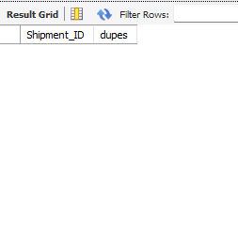
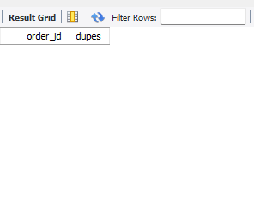
● Identify and delete duplicate Order_ID or Shipment_ID records. .
Results
Queries
SELECT order_id, COUNT(*) AS dupesFROM orders_fedex
group by order_id
having dupes >1;
SELECT Shipment_ID, COUNT(*) AS dupes FROM shipments_fedex
GROUP BY Shipment_ID
HAVING dupes > 1;
-- there are no dupes in oreder_id and shipment_id

Slide 4
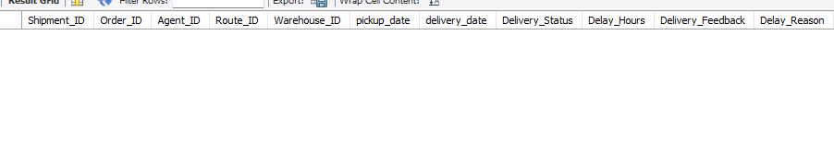
Replace null or missing Delay_Hours values in the Shipments Table with the average delay for that Route_ID
select * from shipments_fedex
where delay_hours is null;
there is no null values in delay hours

Slide 5
Convert all date columns (Order_Date, Pickup_Date, Delivery_Date) into YYYY-MM-DD HH:MM:SS format using SQL date functions.
alter table shipments_fedex
modify column pickup_date datetime,
modify column delivery_date datetime;
alter table orders_fedex
modify column order_datedatetime

Slide 6
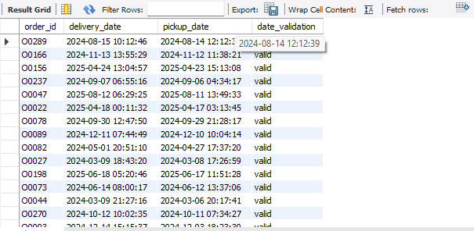
4.Ensure that no Delivery_Date occurs before Pickup_Date (flag such records)..
Queries
Table
SELECT order_id, delivery_date, pickup_date, CASE WHEN delivery_date < pickup_date THEN 'invalid' ELSE 'valid' END AS date_validationFROM shipments_fedex;
Screenshot
there is no invalid pickup date or delivery date

Slide 7
Task 2: Delivery Delay Analysis

Slide 8
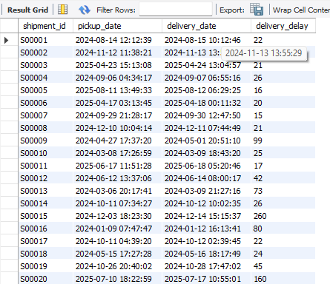
1.Calculate delivery delay (in hours) for each shipment using Delivery_Date – Pickup_Date
Queries
SELECT shipment_id, pickup_date, delivery_date, TIMESTAMPDIFF(HOUR, pickup_date, delivery_date) AS delivery_delay FROM shipments_fedex;
Table
Screenshot

Slide 9
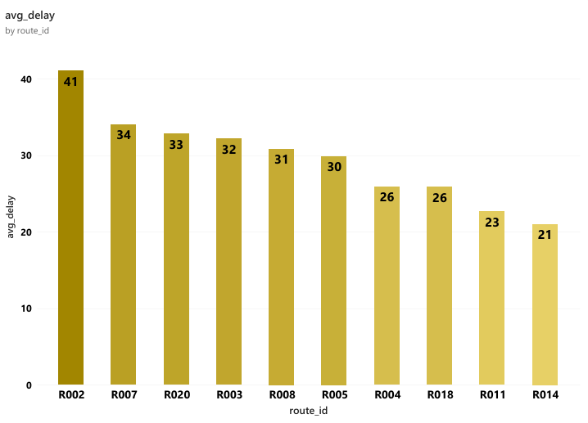
Find the Top 10 delayed routes based on average delay hours
Queries
SELECT route_id, ROUND(AVG(delay_hours), 2) AS avg_delay FROM shipments_fedex
GROUP BY route_id ORDER BY avg_delay DESC LIMIT 10;
Chart
Table

Slide 10
3.Use SQL window functions to rank shipments by delay within each Warehouse_ID
Queries
select shipment_id,warehouse_id, dense_rank() over(partition by Warehouse_ID order by delay_hours desc) as rank_ from shipments_fedex;
Table

Slide 11
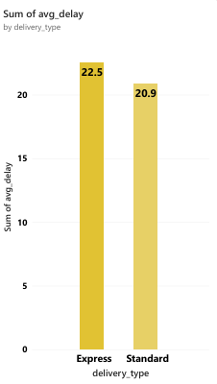
4.Identify the average delay per Delivery_Type (Express / Standard) to compare service-level efficiency.
Queries
SELECT o.delivery_type, ROUND(AVG(s.delay_hours), 2) AS avg_delay FROM orders_fedex o INNER JOIN shipments_fedex s ON o.order_id = s.order_id
GROUP BY delivery_type;
Chart
Table

Slide 12
Task 3: Route Optimization Insights

Slide 13

1. Average transit time (in hours) across all shipments. .
Queries
select avg(timestampdiff(hour , pickup_date, delivery_date)) as avg_transit_time from shipments_fedex;

Slide 14
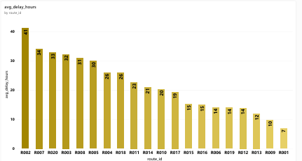
2.Average delay (in hours) per route.. .
Queries
select route_id, round(avg(delay_hours),2) as avg_delay_hours from shipments_fedex
group by route_id order by avg_delay_hours desc;
Table
Chart

Slide 15
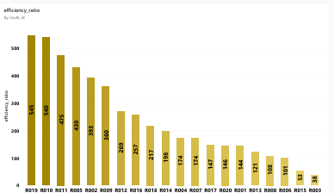
3.Distance-to-time efficiency ratio = Distance_KM / Avg_Transit_Time_Hours.
Queries
select route_id, distance_km, Avg_Transit_Time_Hours, round(distance_km/Avg_Transit_Time_Hours, 3) as efficiency_ratio from routes_fedex;
Table
Chart

Slide 16
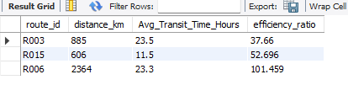
4.Identify 3 routes with the worst efficiency ratio (lowest distance-to-time).
Queries
SELECT route_id, distance_km, Avg_Transit_Time_Hours, ROUND(distance_km / Avg_Transit_Time_Hours, 3) AS efficiency_ratio FROM routes_fedex
ORDER BY efficiency_ratio ASC LIMIT 3;
Table

Slide 17
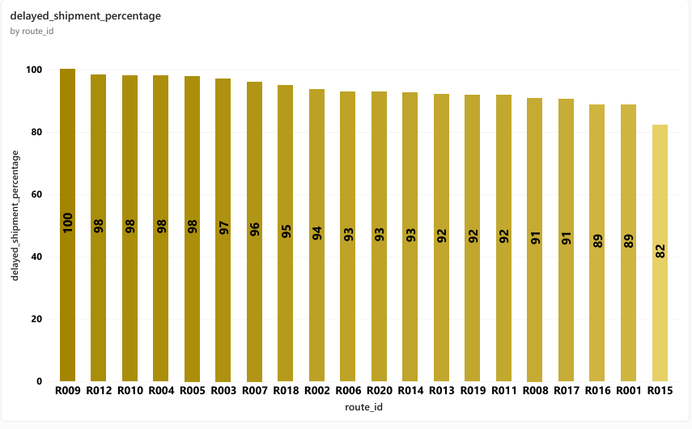
5.Find routes with >20% of shipments delayed beyond expected transit time.
Queries
Table
SELECT route_id, COUNT(*) AS total_shipment, SUM(CASE WHEN delay_hours > 0 THEN 1 ELSE 0 END) AS delayed_shipment, ROUND(SUM(CASE WHEN delay_hours > 0 THEN 1 ELSE 0 END) / COUNT(*), 3) * 100 AS delayed_shipment_percentage FROM shipments_fedex
GROUP BY route_id
HAVING delayed_shipment_percentage > 20
ORDER BY delayed_shipment_percentage DESC;

Slide 18
Recommend potential routes or hub pairs for optimization
based on poor efficiency, route R003, R015, R006 need optimization

Slide 19
Task 4: Warehouse Performance

Slide 20
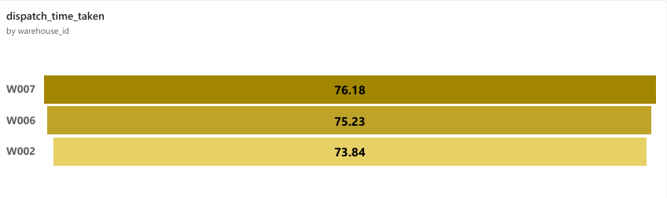
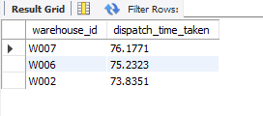
1. Find the top 3 warehouses with the highest average delay in shipments dispatched
Queries
select s.warehouse_id, avg(timestampdiff(hour, o.order_date, s.pickup_date)) as dispatch_time_taken from shipments_fedex s inner join orders_fedex oon s.order_id = o.order_id
group by warehouse_id
order by dispatch_time_taken desc limit 3;
as there is no column named dispatch time in any table, we have to calculate dispatch time with formulla pickup_date - order_date
Funnel chart
Table
warehouse w007, w006, w002 has the highest time diff between order_date and pickup_date

Slide 21
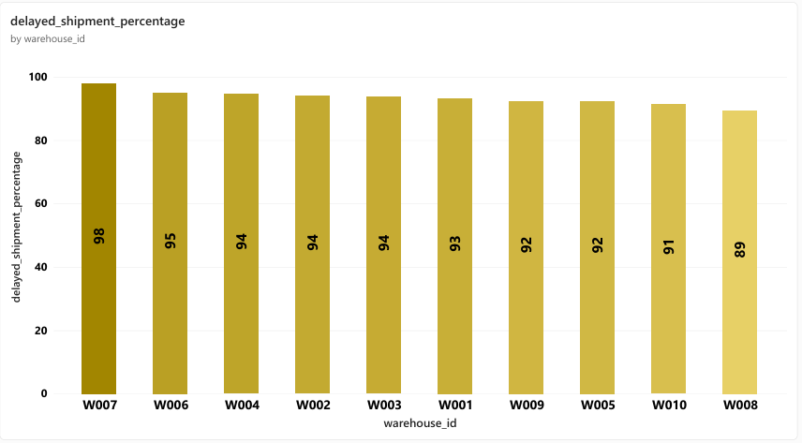
2.Calculate total shipments vs delayed shipments for each warehouse
Queries
select warehouse_id, count(*) as total_shipment,sum(case when delay_hours >0 then 1 else 0 end) as delayed_shipment,round(sum(case when delay_hours >0 then 1 else 0 end)/ count(*),3)*100 as delayed_shipment_percentage from shipments_fedex
group by warehouse_id
order by delayed_shipment_percentage desc;
chart
Table

Slide 22
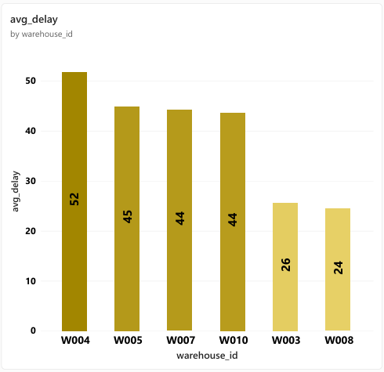
3. Use CTEs to identify warehouses where average delay exceeds the global average delay.
Queries
with warehouse_delay as(select warehouse_id, round(avg(delay_hours),2) avg_delay from shipments_fedexgroup by warehouse_id)
select w.*, round(avg(s.delay_hours) over(),2) as global_avg from warehouse_delay w inner join shipments_fedex s
where avg_delay > (select avg(delay_hours) from shipments_fedex)limit 10;
chart
Table

Slide 23
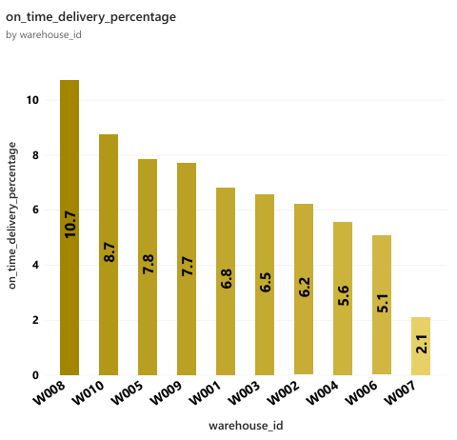
4.Rank all warehouses based on on-time delivery percentage.
Queries
with warehouse_delay as(select warehouse_id, round(avg(delay_hours),2) avg_delay from shipments_fedexgroup by warehouse_id)
select w.*, round(avg(s.delay_hours) over(),2) as global_avg from warehouse_delay w inner join shipments_fedex s
where avg_delay > (select avg(delay_hours) from shipments_fedex)limit 10;
chart
Table
Table

Slide 24
Task 5: Delivery Agent Performance

Slide 25
1 .Rank delivery agents (per route) by on-time delivery percentage.
Queries
Table
with timly_delivery as(select route_id,Agent_ID,count(*)as total_delivery ,sum(case when delay_hours =0 then 1 else 0 end) as on_time_delivery,
round(sum(case when delay_hours =0 then 1 else 0 end)/count(*),2)*100 as on_time_delivery_percentage from shipments_fedex
group by route_id,Agent_ID)
select * , rank() over(partition by route_id order by on_time_delivery_percentage desc) as agent_rank from timly_delivery;

Slide 26
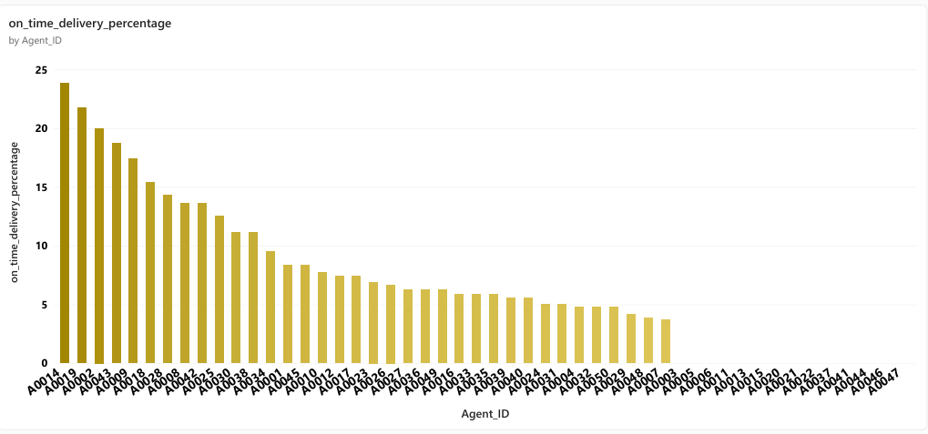
2.Find agents whose on-time % is below 85%.
Queries
with warehouse_delay as(select warehouse_id, round(avg(delay_hours),2) avg_delay from shipments_fedexgroup by warehouse_id)
select w.*, round(avg(s.delay_hours) over(),2) as global_avg from warehouse_delay w inner join shipments_fedex s
where avg_delay > (select avg(delay_hours) from shipments_fedex)limit 10;
Table
chart

Slide 27
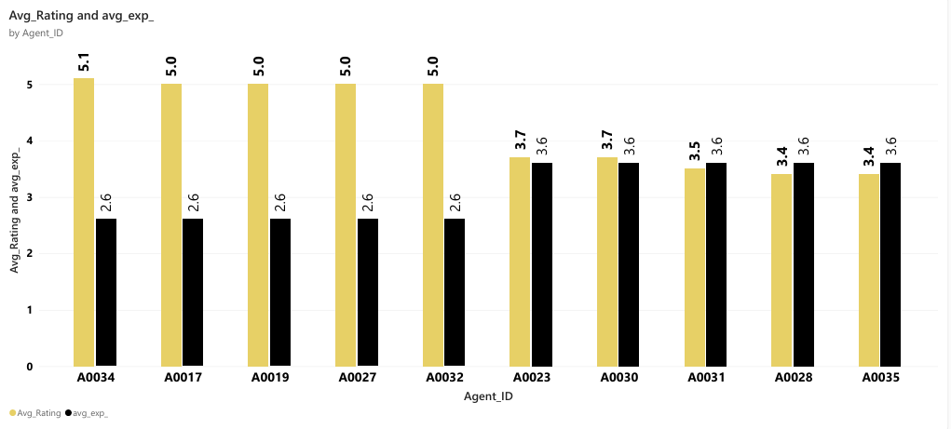
3.Compare the average rating and experience (in years) of the top 5 vs bottom 5 agents using subqueries.
Queries
select *, avg(experience_years) over() as avg_exp_of_5,round(avg(avg_rating) over(),2) as avg_rating_of_5 from (
select Agent_ID,Agent_Name,Experience_Years,Avg_Rating from fedex_agentsorder by avg_rating desc limit 5) as top_5union allselect *, avg(experience_years) over() avg_exp_of_5, avg(avg_rating) over() as avg_rating_of_5 from (select Agent_ID,Agent_Name,Experience_Years,Avg_Rating from fedex_agentsorder by avg_rating asc limit 5) as top_5;
Table
chart

Slide 28
Task 6: Shipment Tracking Analytics

Slide 29
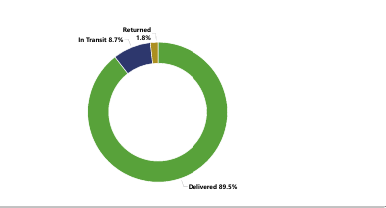
1.For each shipment, display the latest status (Delivered, In Transit, or Returned) along with the latest Delivery_Date.
Queries
select shipment_id, delivery_date, delivery_status from shipments_fedex;
Table
chart

Slide 30
2.Identify routes where the majority of shipments are still “In Transit” or “Returned”
Queries
SELECT route_id, delivery_statusFROM shipments_fedex
WHERE delivery_status IN ('in transit' , 'returned');
Table
chart

Slide 31

3.Find the most frequent delay reasons (if available in delay-related columns or flags)
Queries
SELECT delay_reason, COUNT(*) AS frequency FROM shipments_fedex
GROUP BY delay_reason
ORDER BY frequency DESC
LIMIT 1;
Table

Slide 32
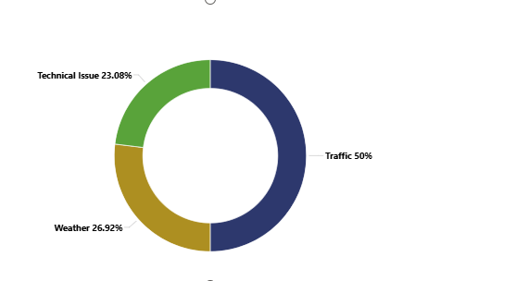
4. Identify orders with exceptionally high delay (>120 hours) to investigate potential bottlenecks.
Queries
SELECT *FROM shipments_fedex
WHERE delay_hours > 120
ORDER BY delay_hours DESC;
Table
chart

Slide 33
Task 7: Advanced KPI Reporting

Slide 34
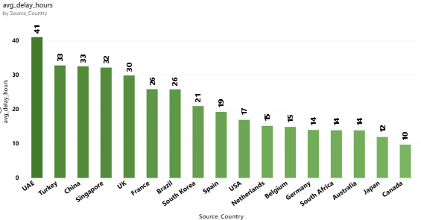
1 Average Delivery Delay per Source_Country.
Table
Queries
SELECT r.Source_Country, ROUND(AVG(s.delay_hours), 3) AS avg_delay_hours FROM routes_fedex r INNER JOIN shipments_fedex s ON r.route_id = s.route_id
GROUP BY Source_Country
ORDER BY avg_delay_hours DESC;
chart

Slide 35

2. On-Time Delivery % = (Total On-Time Deliveries / Total Deliveries) * 100
Queries
SELECT
(SUM(CASE WHEN delay_hours = 0 THEN 1 ELSE 0 END) / COUNT(*)) * 100 AS total_on_time_delivery_percentage
FROM shipments_fedex;
Table

Slide 36
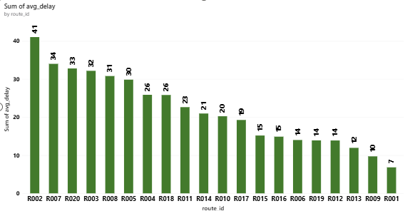
3. Average Delay (in hours) per Route_ID
Table
Queries
SELECT route_id, ROUND(AVG(delay_hours), 2) AS avg_delay FROM shipments_fedex
GROUP BY route_id
ORDER BY avg_delay DESC;
chart

Slide 37
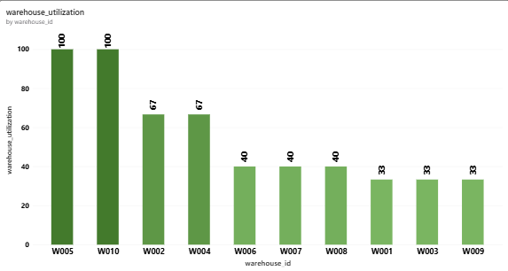
4. Warehouse Utilization %
Table
Queries
with shipments as(SELECT warehouse_id, COUNT(*) AS shipments FROM shipments_fedexgroup by warehouse_idorder by shipments desc)
SELECT w.warehouse_id, w.Capacity_per_day, s.shipments, (s.shipments / w.Capacity_per_day) * 100 AS warehouse_utilization
FROM warehouses_fedex w INNER JOIN shipments s
chart

Slide 38
Video link of the project
https://drive.google.com/file/d/1uEgtZau7poekuUXu7oIWeKBf7nNisWlF/view?usp=sharing

